Slide 1

Doctor’s Appointment Management system
By Moulya E(kothi)

Slide 2

Problem Statement
The aim is to develop Doctor's Appointment System which is a simple project that will help a certain medical establishment such as a clinic or a hospital client/patients to request an appointment with the doctor online. This project can also help doctors to manage the schedules of their appointments with their patients.

Slide 3





The Tables used
Doctors
Patients
Appointment Schedule
Booking
ADMIN

Slide 4





TECHNOLOGIES USED
HTML
CSS
.
PHP
MYSQL

Slide 5

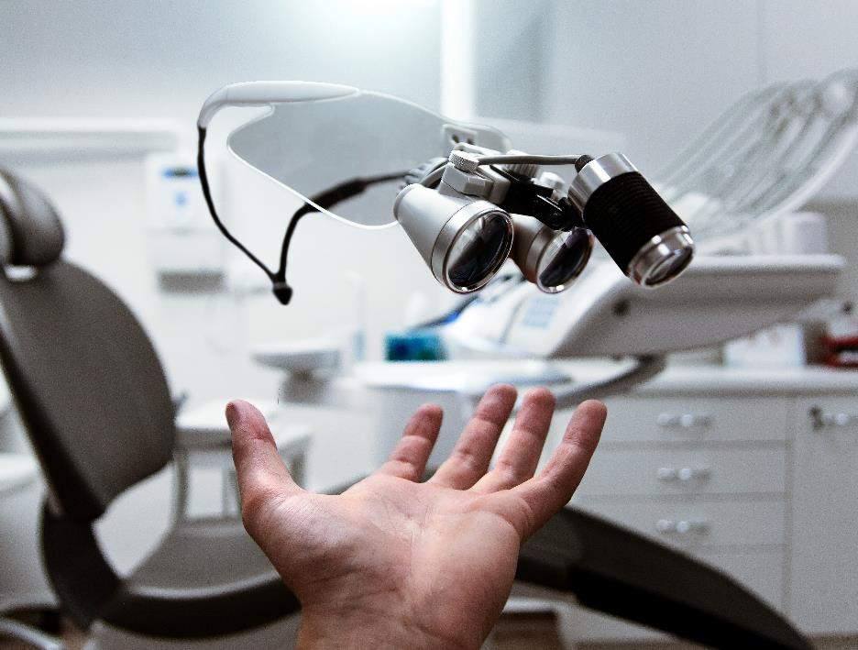
ER Diagram

Slide 6





Thank You
April Hansson
+1 23 987 6554
april@contoso.com
www.contoso.com

